Slide 1
Shuttle 1.0
Kao, Chen-yi
2009-04-??05

Slide 2
Shuttle 1.0: an open domain model completion tool
Built on the base of Shuttle project
Performance tuning – utilizing Eclipse concurrency
Open domain model completion
  ??research topics
  Client-server model analysis

Slide 3
Outline
Short-term plan (within a year)
  Related works
  Client-side
    (Structural) rule inference result recommendation (RIRR) visualization
      ??GMF MPM
  Server-side
    Light-weight rule-base

Slide 4
Client-side: RIRR visualization
??Reduce semantic noise
??Extended from concept linking...
  OWL ontology linking
  SWRL rule triggering
    hasParent(?x1,?x2) ∧ hasBrother(?x2,?x3) ⇒ hasUncle(?x1,?x3)
  SWRL rule inference
    Direct inference
    Indirect inference by KAON2(http://kaon2.semanticweb.org/) reasoner
  RIRR visualization
    ??MDA-lized rules
    ??GMF MPM model completion recommendation
    Case by case...

Slide 5
Client-side: RIRR visualization (cont.)
Divided in three research topics...
  Infering model via Concept mapping technique
  Generating rules from GMF editor definitions for model completion recommendation
  Extracting GMF editor rules for model completion recommendation without editor definitions

Slide 6
Client-side: RIRR visualization (cont.)
Infering model via Concept mapping technique??
  Concept linking (mapping)
  OWL ontology linking
  SWRL rule triggering
    hasParent(?x1,?x2) ∧ hasBrother(?x2,?x3) ⇒ hasUncle(?x1,?x3)
  SWRL rule inference
    Direct inference
    Indirect inference by KAON2(http://kaon2.semanticweb.org/) reasoner

Slide 7
??MDA-lized Rules
MPM rules
  Tag MPM elements
Cache MPM elements
GMF editor difinition rules
  For GMF-involved MPM
  Mining GMF editor difinition rules for model completion recommendation
    When editor difinitions are not available for some reason

Slide 8
Application of Web design
Eclipse WTP Web Page Editor (WPE)
Tag WPE elements
Cache WPE elements

Slide 9
Performance tuning -
Utilizing Eclipse concurrency
For long running operations
  Client-side: to improve response time
    WordNet lexical base search related - concept mapping & ontology linking
    KAON2 reasoning related
  Server-side: to utilize I/O (network and/or disk) waiting time
    Rule base indexing
  Others recognized in the future

Slide 10
Eclipse concurrency
Jobs (org.eclipse.core.runtime.jobs.Job)
  One job a thread
  Can be scheduled to re-run
  Typically completing a task per run
Progress (org.eclipse.core.runtime.IProgressMonitor)
  System Jobs vs. User Jobs
    Set Jobs as User Jobs to enable showing progress
  Each task is responsible to a 0~100% progress reporting

Slide 11
Single-job-many-tasks model
For concept mapping (concept rule construction)
Mappings for some accumulated model elements constitute a "task"
Trade-off between job run overhead and unpredictability of element number

Slide 13
Inferring model via Concept mapping technique
Extended from concept linking...
  OWL ontology linking
  SWRL rule triggering
    hasParent(?x1,?x2) ∧ hasBrother(?x2,?x3) ⇒ hasUncle(?x1,?x3)
  SWRL rule inference
    Direct inference
    Indirect inference by KAON2(http://kaon2.semanticweb.org/) reasoner

Slide 14
Client-server model analysis
Inferring model via Concept mapping technique
  Concept mapping for both GMF model and OWL ontology elements
  (OWL ontology linking)
  SWRL rule triggering
    hasParent(?x1,?x2) ∧ hasBrother(?x2,?x3) ⇒ hasUncle(?x1,?x3)
  SWRL rule inference
    Indirect inference by KAON2 reasoner / Direct inference

Slide 15
Client-server model of model inference
Client-side
Server-side
Concept mapping for GMF model element
Concept mapping for OWL ontology element
OWL ontology linking
SWRL rule triggering
SWRL rule indexing by concept
SWRL rule inference

Slide 16
Client-side scheme
OWL ontology linking
SWRL rule triggering
  hasParent(?x1,?x2) ∧ hasBrother(?x2,?x3) ⇒ hasUncle(?x1,?x3)
SWRL rule inference
  Direct inference
  Indirect inference by KAON2(http://kaon2.semanticweb.org/) reasoner
Rule inference result recommendation visualization

Slide 18
Shuttle 1.0 divided in three research topics
Inferring model via Concept mapping technique (with client-server collaboration)
Generating rules from GMF editor definitions for model completion recommendation
Extracting GMF editor rules for model completion recommendation without editor definitions

Slide 19
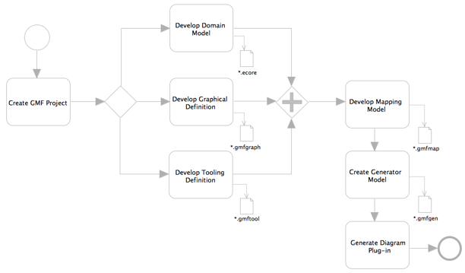
Generating rules from GMF editor definitions for model completion recommendation

Slide 20
Generating rules from GMF editor definitions for model completion recommendation (cont.)
GMF editor definitions
  Domain Model Definition
  Graphical Definition
  Tooling Definition
  Mapping Definition
Model completion recommendation – rule inference result recommendation visualization

Slide 21
Extracting GMF editor rules for model completion recommendation without editor definitions
When editor definitions are not available
  ex. hidden source
Extracting by...
  Is there any right-prepared rum-time editor API?
  Or reverse engineering / code mining?
A universal solution

Slide 22
Using MDA to bridge I and II
Model Driven Architecture (MDA)
  PIM(medicine) + PM(Java) = PSM
  PIM: platform independent model
  PM: platform model
  PSM: platform specific model
PM-tagging rules
GMF editor definitions as PM
  GMF editor rules as PM rules

Slide 23
Shuttle 1.0: Divided in four research topics...
Inferring model via Concept mapping technique
Generating rules from GMF editor definitions for model completion recommendation
Extracting GMF editor rules for model completion recommendation without editor definitions
III. MDA-based inference for model completion recommendation visualization

Slide 24
Shuttle 1.0: research topics
Inferring model via Concept mapping technique
Generating rules from GMF editor definitions for model completion recommendation
Extracting GMF editor rules for model completion recommendation without editor definitions
III. MDA-based model inference for model completion visualization

Slide 25
Related research
Domain-specific Model Editors with Model Completion (http://www.irisa.fr/triskell/publis/2007/Sen07b.pdf)
  For AToM (A Tool for Multi-formalism and Meta-Modelling) platform (http://atom3.cs.mcgill.ca/)
  Forward editor generation

Slide 26
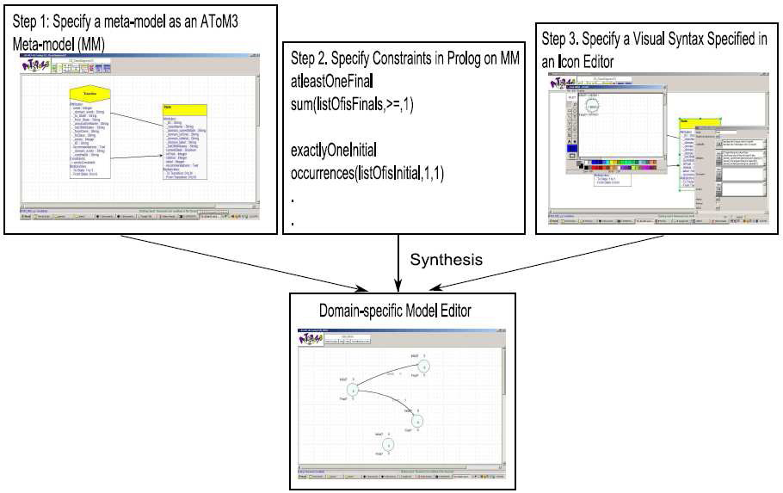
The AToM³ example of FSM: A Domain-specific Model Editor with Prolog Model Completion Rules

Slide 27
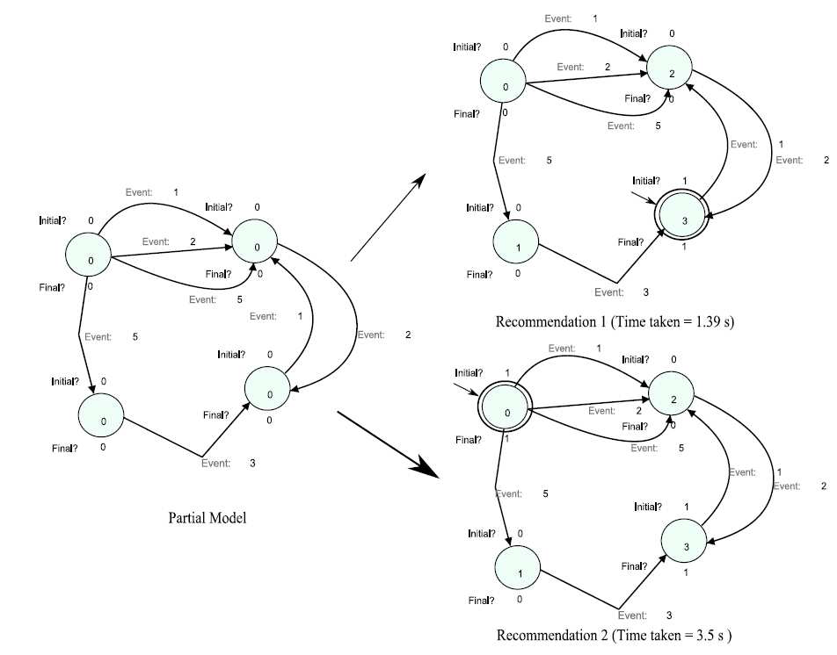
Model Completion example of the AToM³ FSM

Slide 28
A SWRL rule example
A UML state chart finite state machine based on the AToM³ example
  For comparison purpose
    To Shuttle, SWRL rule source is open,
      can be translated from in-model constraints
      or from third-party libraries
  As a test case

Slide 29
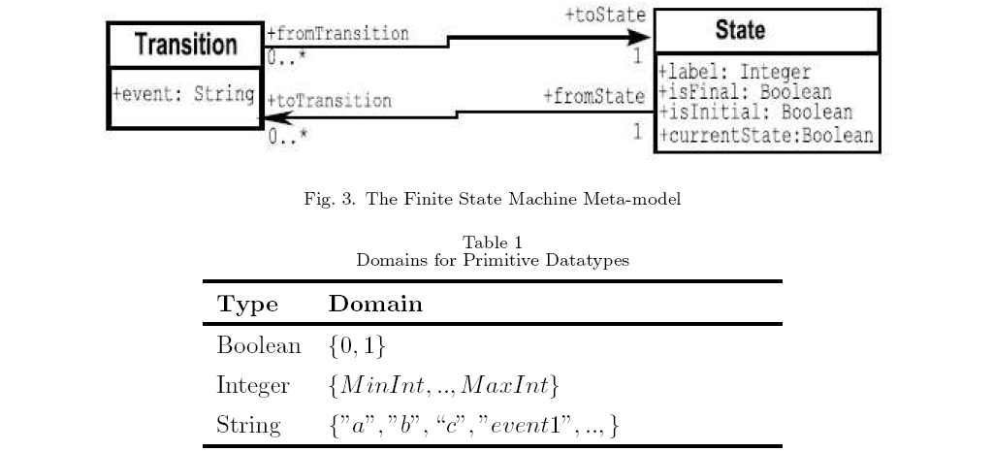
Meta-model of the AToM³ example

Slide 30
SWRL rule example –
FSM in UML State Machine
For comparison purpose
  To Shuttle, SWRL rule source is open,
    can be translated from in-model constraints
    or from third-party libraries
As a test case. UML2 State Machine editor is bundled in Eclipse Ganymede
  UML 1.3 meta-model in RDF is available
    http://infolab.stanford.edu/~melnik/rdf/uml/
    UML State Machine: http://infolab.stanford.edu/~melnik/rdf/uml/uml-state-20000507.rdf

Slide 31
Rules correspondent to the meta-model
UML diagram part
  UML to RDF converters (e.g. Duet) available
Table part - manually converted rules
  Boolean as xsd:boolean
  Integer as xsd:integer
  String as
DatatypeProperty( #event range( oneOf( “a” “b” “c” “event1” ... ) ) )

Slide 32
Rules correspondent to the meta-model
UML diagram part
  UML to RDF converters/transformers
    Duet (http://projects.semwebcentral.org/projects/codip/)
      Support ONLY older version 1.3/1.4 of UML
    Eclipse Atlas Transformation Language (ATL) UML2OWL transformation (http://www.eclipse.org/m2m/atl/usecases/ODMImplementation/)
      Unknown error in processing the conversion
  Appending manual transformations with model completion recommending scenarios

Slide 33
Combined rules from both diagram and table part
For diagram classes
  Class( State 'partial'
restriction( #label cardinality(1) )
restriction( #label allValuesFrom(xsd#integer) )
restriction( #isFinal cardinality(1) )
restriction( #isFinal allValuesFrom(xsd#boolean) )
restriction( #isInitial cardinality(1) )
restriction( #isInitial allValuesFrom(xsd#boolean) )
restriction( #currentState cardinality(1) )
restriction( #currentState allValuesFrom(xsd#boolean) )
)

Slide 34
For diagram classes (cont.)
  Class( Transition 'partial'
restriction( #event cardinality(1) )
restriction( #event someValuesFrom( oneOf( “a” “b” “c” “event1” ... ) ) )

Slide 35
For diagram associations (including explicit and implicit navigability & cardinality)
ObjectProperty( toState Functional domain(#Transition) range(#State) )
ObjectProperty( toTransition InverseFunctional domain(#State) range(#Transition) )
ObjectProperty( fromState inverseOf(#toTransition) Functional )
ObjectProperty( fromTransition inverseOf(#toState) InverseFunctional )

Slide 36
The Prolog rules
Correspondent SWRL rules maybe (given only one machine per diagram):
  AtLeastOneFinalState: sum(listOfisFinal,>=,1)
fsm:FinalState( ?x ) ⇒ swrlb:member( ?x, ?fslist )
builtIn(
swrlb:booleanNot,
swrlb:empty( ?fslist ), 'true' )
shuttle:subLabel( ?x, 'final' ) ^ shuttle:subLabel( ?x, 'state' ) ^ shuttle:subLabel( ?x, 'false' )
⇒ builtIn(
swrlb:booleanNot,
fsm:FinalState( ?x ), 'true' )

Slide 37
Renewed FSM example rules (cont.)
  exactlyOneInitial: occurrences(listOfisInitial,1,1)
fsm:InitialState( ?x )
⇒ builtIn(
swrlb:booleanNot,
fsm:InitialState( ?y ), 'true' )
shuttle:subLabel( ?x, 'initial' ) ^ shuttle:subLabel( ?x, 'state' ) ^ shuttle:subLabel( ?x, 'false' )
⇒ builtIn(
swrlb:booleanNot,
fsm:InitialState( ?x ), 'true' )

Slide 38
Renewed FSM example rules (cont.)
  alldifferent: all_different(listOfVariables)
fsm:State( ?x ) ^ fsm:label( ?x, ?a ) ^ fsm:State( ?y ) ^ fsm:label( ?y, ?a )
⇒ sameAs( ?x, ?y )
RDF-style lists are NOT supported by OWL-DL, so we have to deal with them specifically

Slide 39
Nested (recursive) MPM-PM rule triggering/recommending
Hierarchical PMs
  Applied with hierarchical MDA inference
  For reusable and scalable PM rules
Downward triggering
  MPM→PM
  PM→PM
  antecedent→consequent
  Unconditional fact (OWL fact)

Slide 40
Nested (recursive) MPM-PM rule triggering/recommending (cont.)
Upward recommending
  PM→PM
  PM→MPM
  consequent→antecedent
  Unconditional fact

Slide 41
Nested MPM(Modeling Platform Model)-PM rule triggering/recommending example: AtLeastOneFinalState??

Slide 42
Scenarios of recommendings
New element recommending
  Recommending "AtLeastOneFinalState"
Modified element recommending
  Partial modification
    ??
  Deletion
    ??
??

Slide 43
Process of model completion recommending
Pre-modeling knowledge base construction
Incremental modeling:
  Empty model or
  Current element binding → KAON2 axiom building →
Rule triggering
  KAON2 (OWL-DL)/Shuttle rule inference → propagating inference results upward

Slide 44
Process of model completion recommending (cont.)
Recommendation activating:
  inference results on MPM → new element extraction / current element binding → recomm. model construction →
Reaction to applying/denying recommendation

Slide 45
Scenario of recommending AtLeastOneFinalState
Assuming rule suite AtLeastOneFinalState has top priority (for the first recomm.)
Pre-modeling knowledge base construction
  ??(gathering all rules together)
Incremental modeling:
  Empty model or
  Current element binding → KAON2 axiom building →
Rule triggering
  KAON2 (OWL-DL)/Shuttle rule inference → propagating inference results upward

Slide 46
Scenario of recommending AtLeastOneFinalState (cont.)
Recommendation activating:
  inference results on MPM →
  new element extraction / current element binding from results →
  recomm. (completion) model construction →
  hint activation →
  recomm. model displaying
Reaction to applying/denying recommendation

Slide 47
Closed domain inference
domain
??illustration
concept
document

Slide 48
Open (unbounded) domain inference
More flexible & scalable for usual documents with heterogeneous concepts
Heterogeneous concept inference
  ex. coexisting UML State Machine & other (application) domain concepts
  For the highest scalability
    Various inference result recommendations depending on the scope of MPM

Slide 49
Open domain inference (cont.)
Open model element bindings
  Exhaustive (wildcard) binding
  To RDF object/property/subject
  To SWRL variables
  To other domains to form multiple MPMs

Slide 50
Open domain inference (cont.)
Open editor (MPM) rules
  Native editors
    From editor code/API
    UML2 State Machine editor example
      GMF editor definitions as MPM
  Potential editors
    From common PM tagging
    The FSM-over-UML2 example
      FSM rules as MPM

Slide 51
Open domain inference
??illustration
??Suits documents with heterogeneous concepts!

Slide 52
MPM tagging
For native MPM
  Extracting GMF editor rules...
For potential MPM
  By ontology mapping
  Firstly parsing ontology for concept mapping
    ex. parsing user-given FSM rules

Slide 53
Renewed built-in PMs
SWRL PM
  Handling variable binding to model elements
    Exhaustive (wildcard) binding
  Handling RDF-style list related SWRL built-in atoms
    swrlb:member, swrlb:empty, etc.
RDF PM
  Handling RDF-style lists
    List implies collection of model elements
  SWRL_PM↔RDF_PM triggering/recommending
  Model element bindings for object/property/subject

Slide 54
Renewed built-in PMs (cont.)
Shuttle PM (MPM)
  Handling complex label text issues
PM priority to handle contradiction
  For now, Shuttle PM
> native MPM(s)
> potential MPM(s)
> other built-in PMs

Slide 55
Built-in rules
Using KAON2's built-in inference API
  Equivalence of descriptions
    e.g. ??FSM example?
  Satisfiability of descriptions
    e.g. ??FSM example?
  Subsumption of descriptions
    e.g. ??FSM example?

Slide 56
Shuttle 1.0: research topics
Inferring model via Concept mapping technique
Generating rules from GMF editor definitions for model completion recommendation
Extracting GMF editor rules for model completion recommendation without editor definitions
III. MDA-based model inference for model completion visualization

Slide 57
Logical and physical recommendations
Logical recommendations
  Rule inference results
Physical recommendations
  Results to be displayed
  Using recommendation factory for adapting various displaying techniques
    ex. cloned, gray-scale or accessibility styles
For prototype development & future extension...

Slide 58
Tracing bundled GMF editor code
UML2 editors
  Beginning with palette creation tool title (Messages.(...)CreationTool_title)
    Not easy to get the bound view through creation tools
  Or get model element name & view via the element type registry?
    Studying GMF Extensible Type Registry
Other simple example editors
  The simple digital logic editor

Slide 59
Tracing bundled GMF editor code
Reminder: element title → creation tool → element view (without model, just for recommendations)
  ??EditPolicyProvider + CreationTool.performCreation(int button)
??Studying GMF Extensible Type Registry
Code-let example
  ??creation tool & extensible type registry cooperation?

